Slide 1
38C3 Style
Insert 1337 h4x0r code in Space Mono

Slide 26
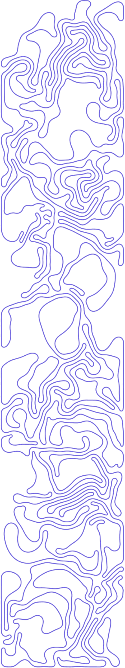


Slide 27




Slide 29

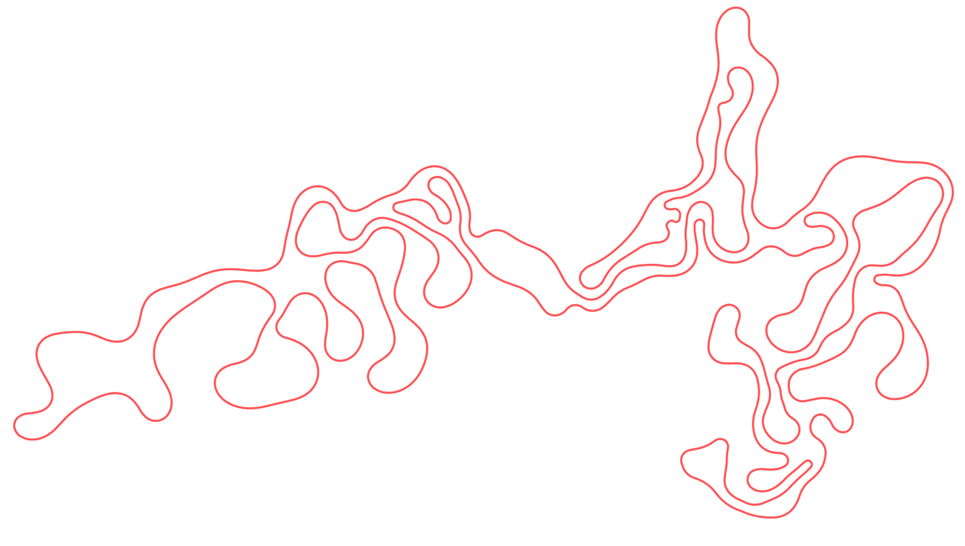


Slide 30
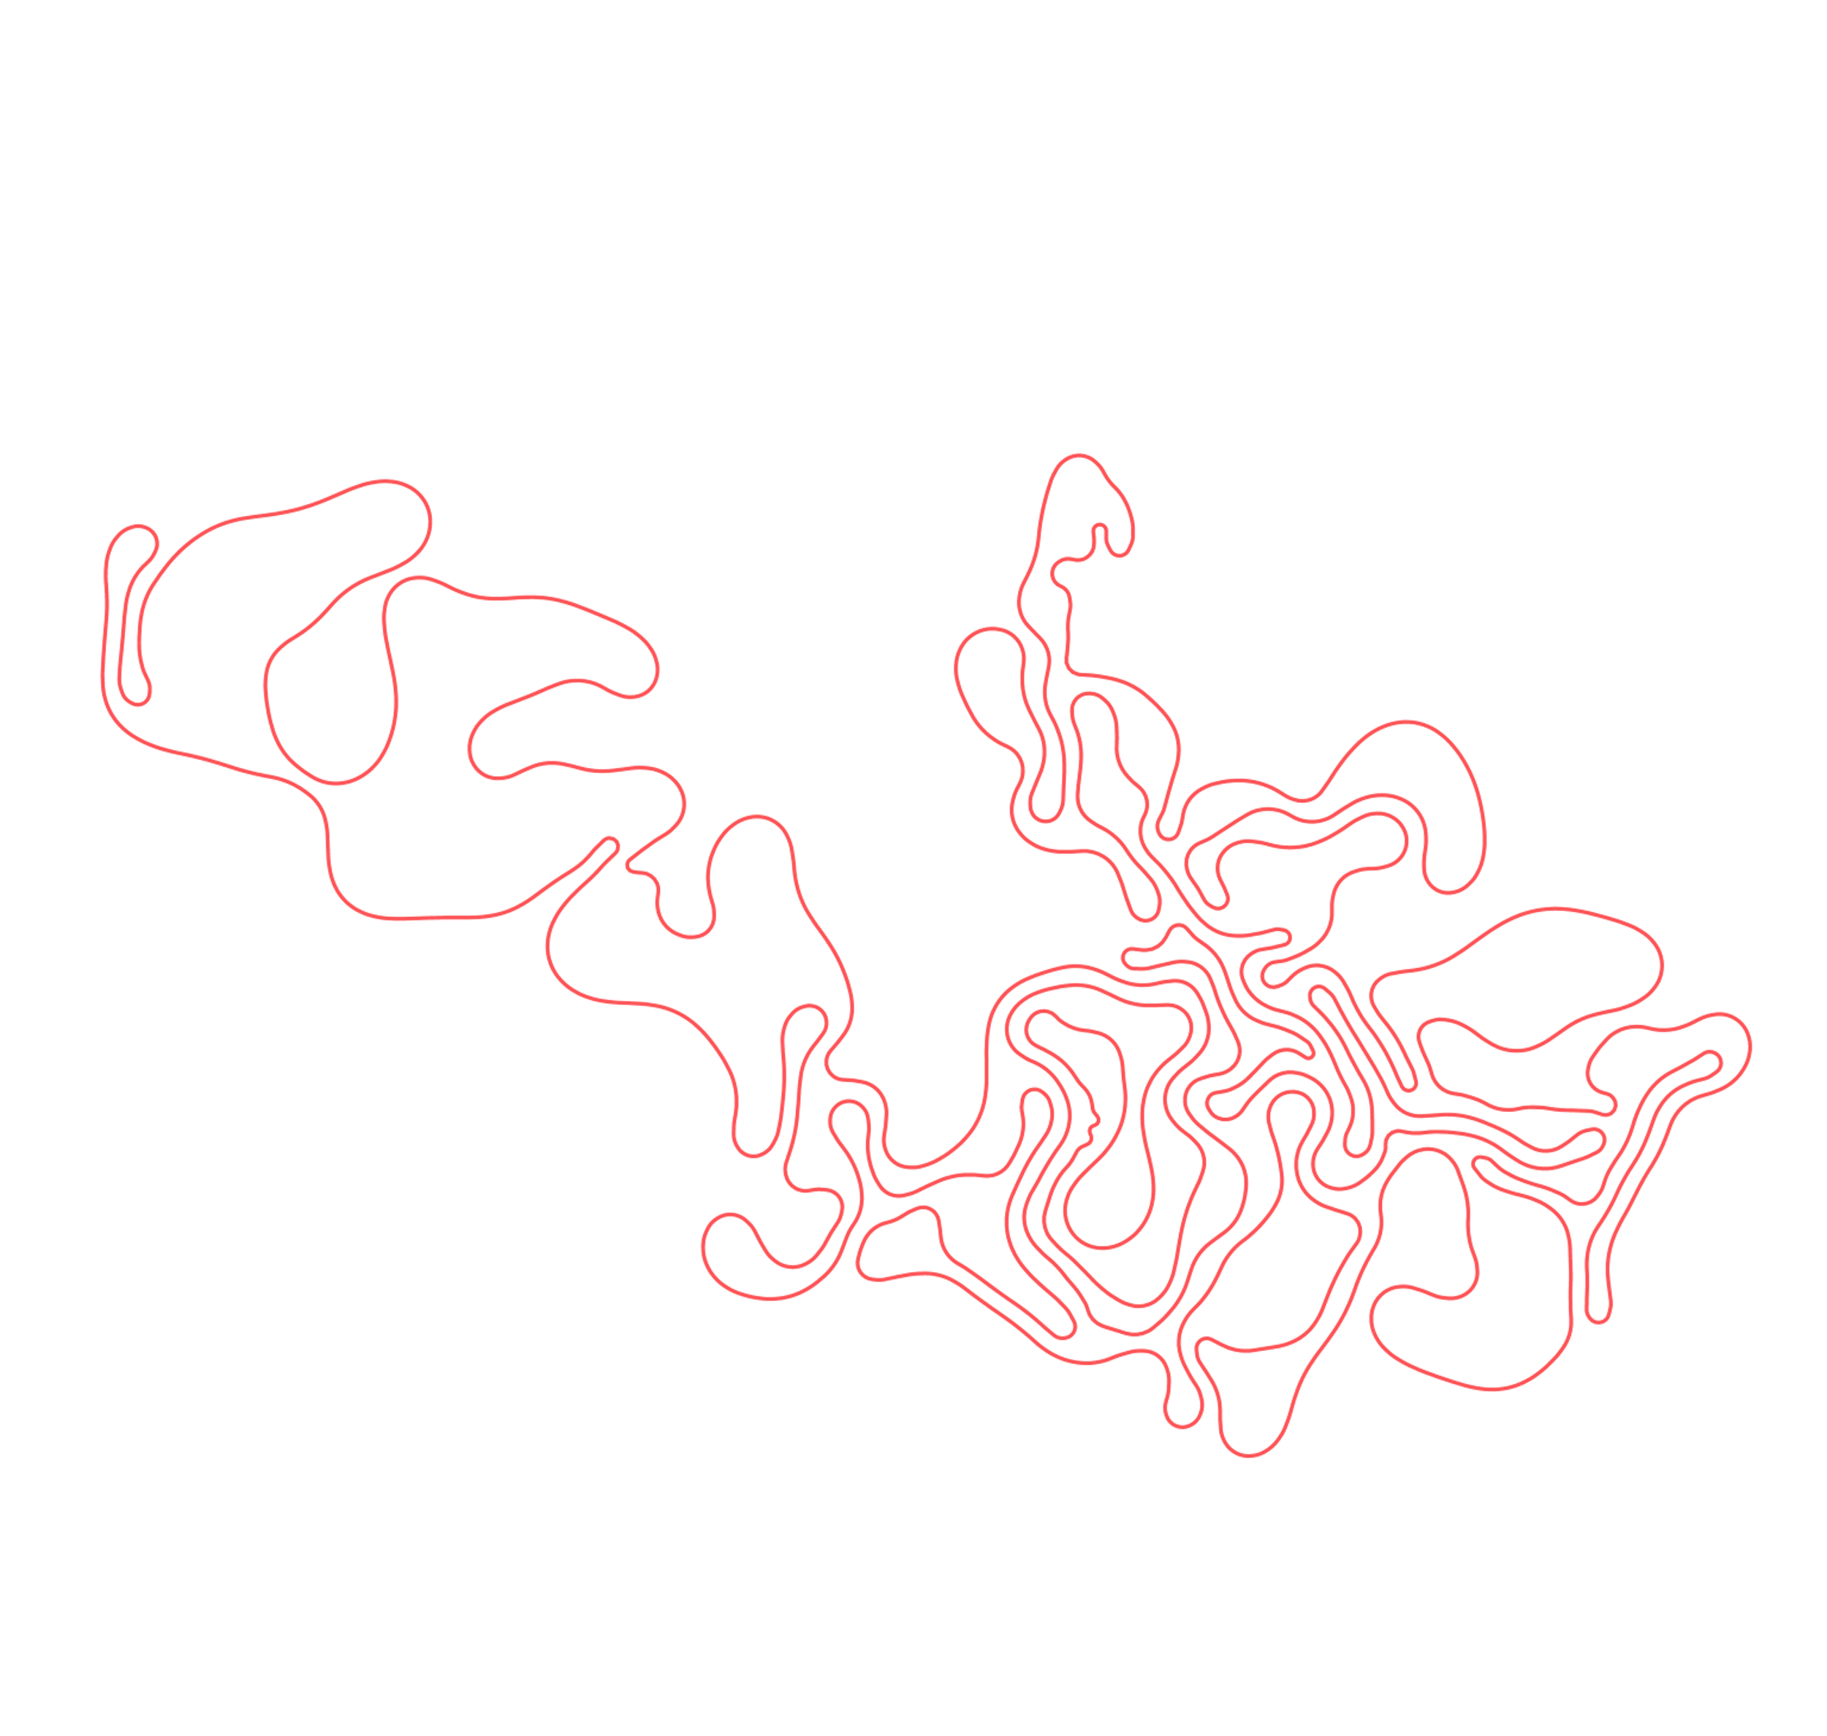

Slide 31


Slide 32


Slide 33


Slide 34


Slide 35


Slide 36


Slide 37


Slide 38
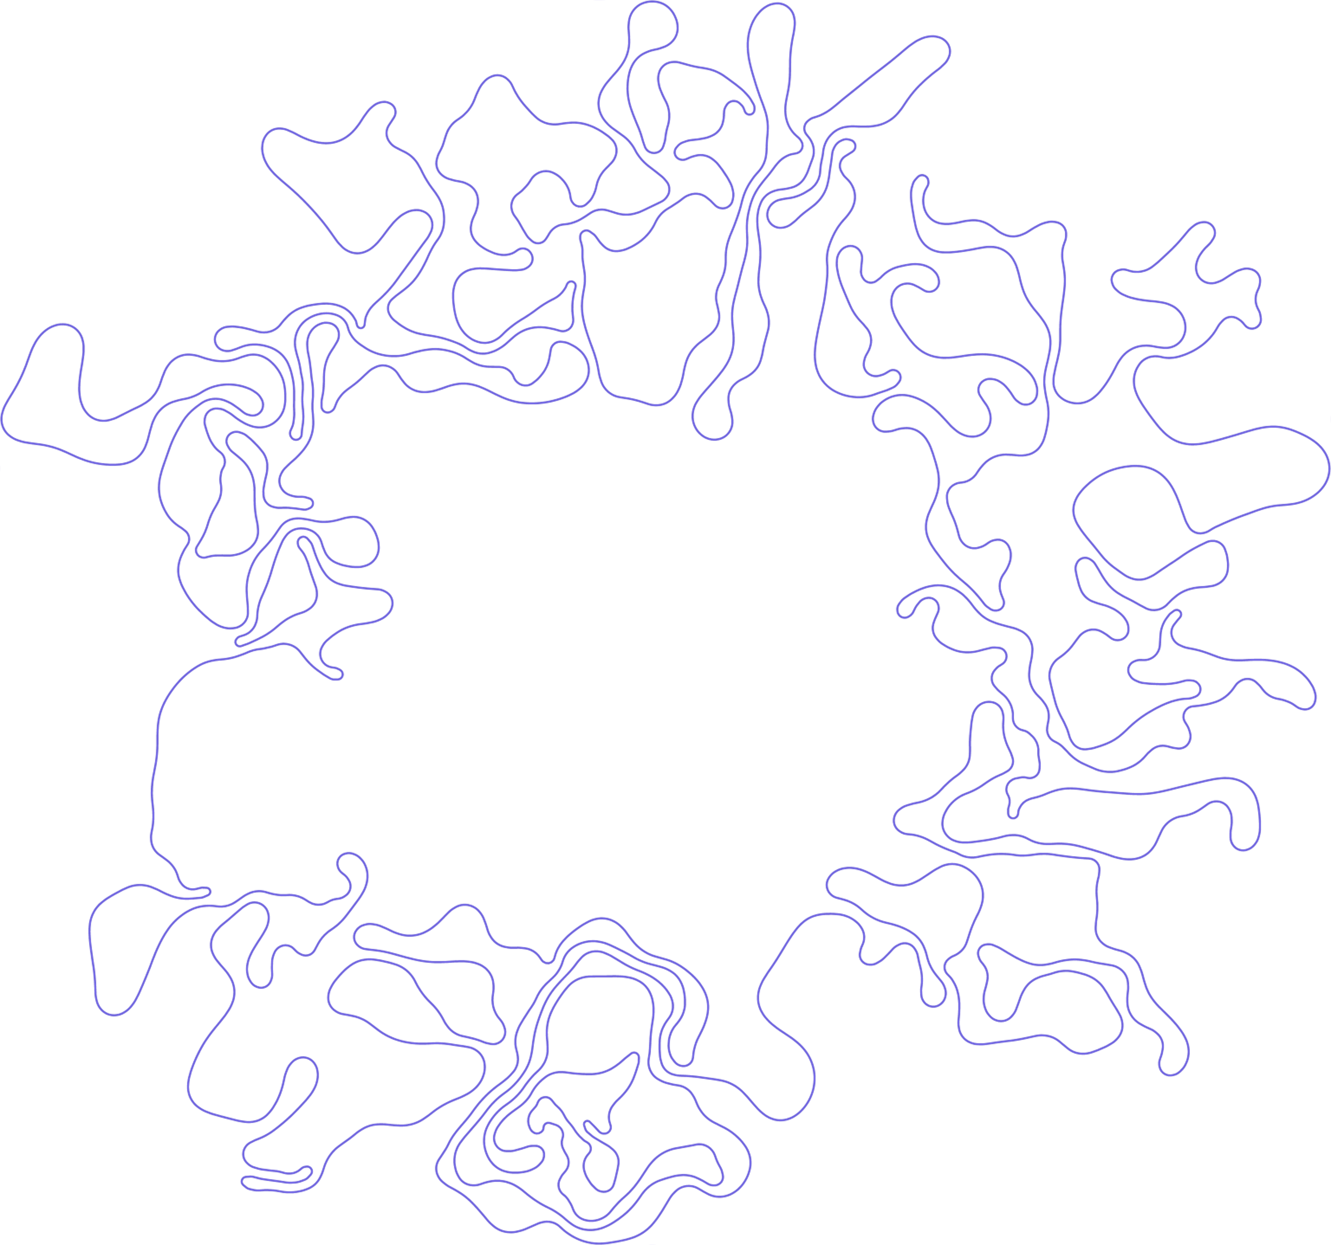

Slide 39


Slide 40
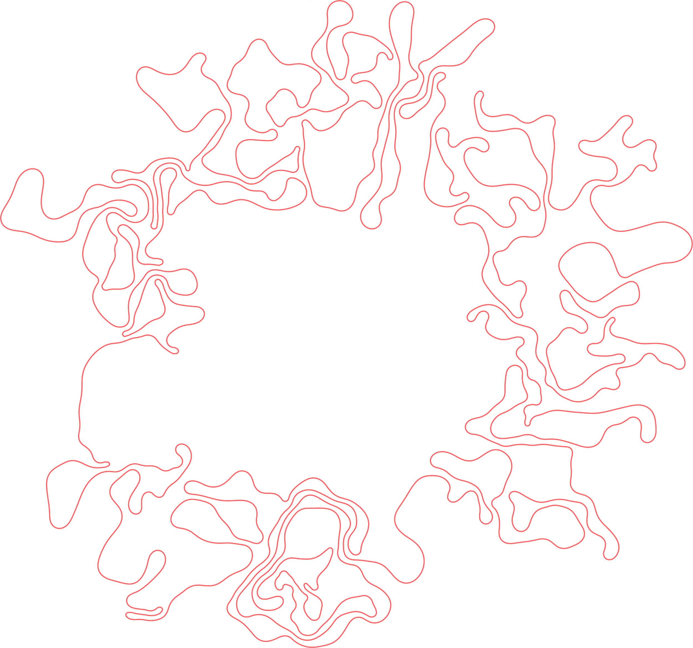

Slide 41



Slide 42


Slide 43


Slide 44


Slide 45


Slide 46


Slide 47
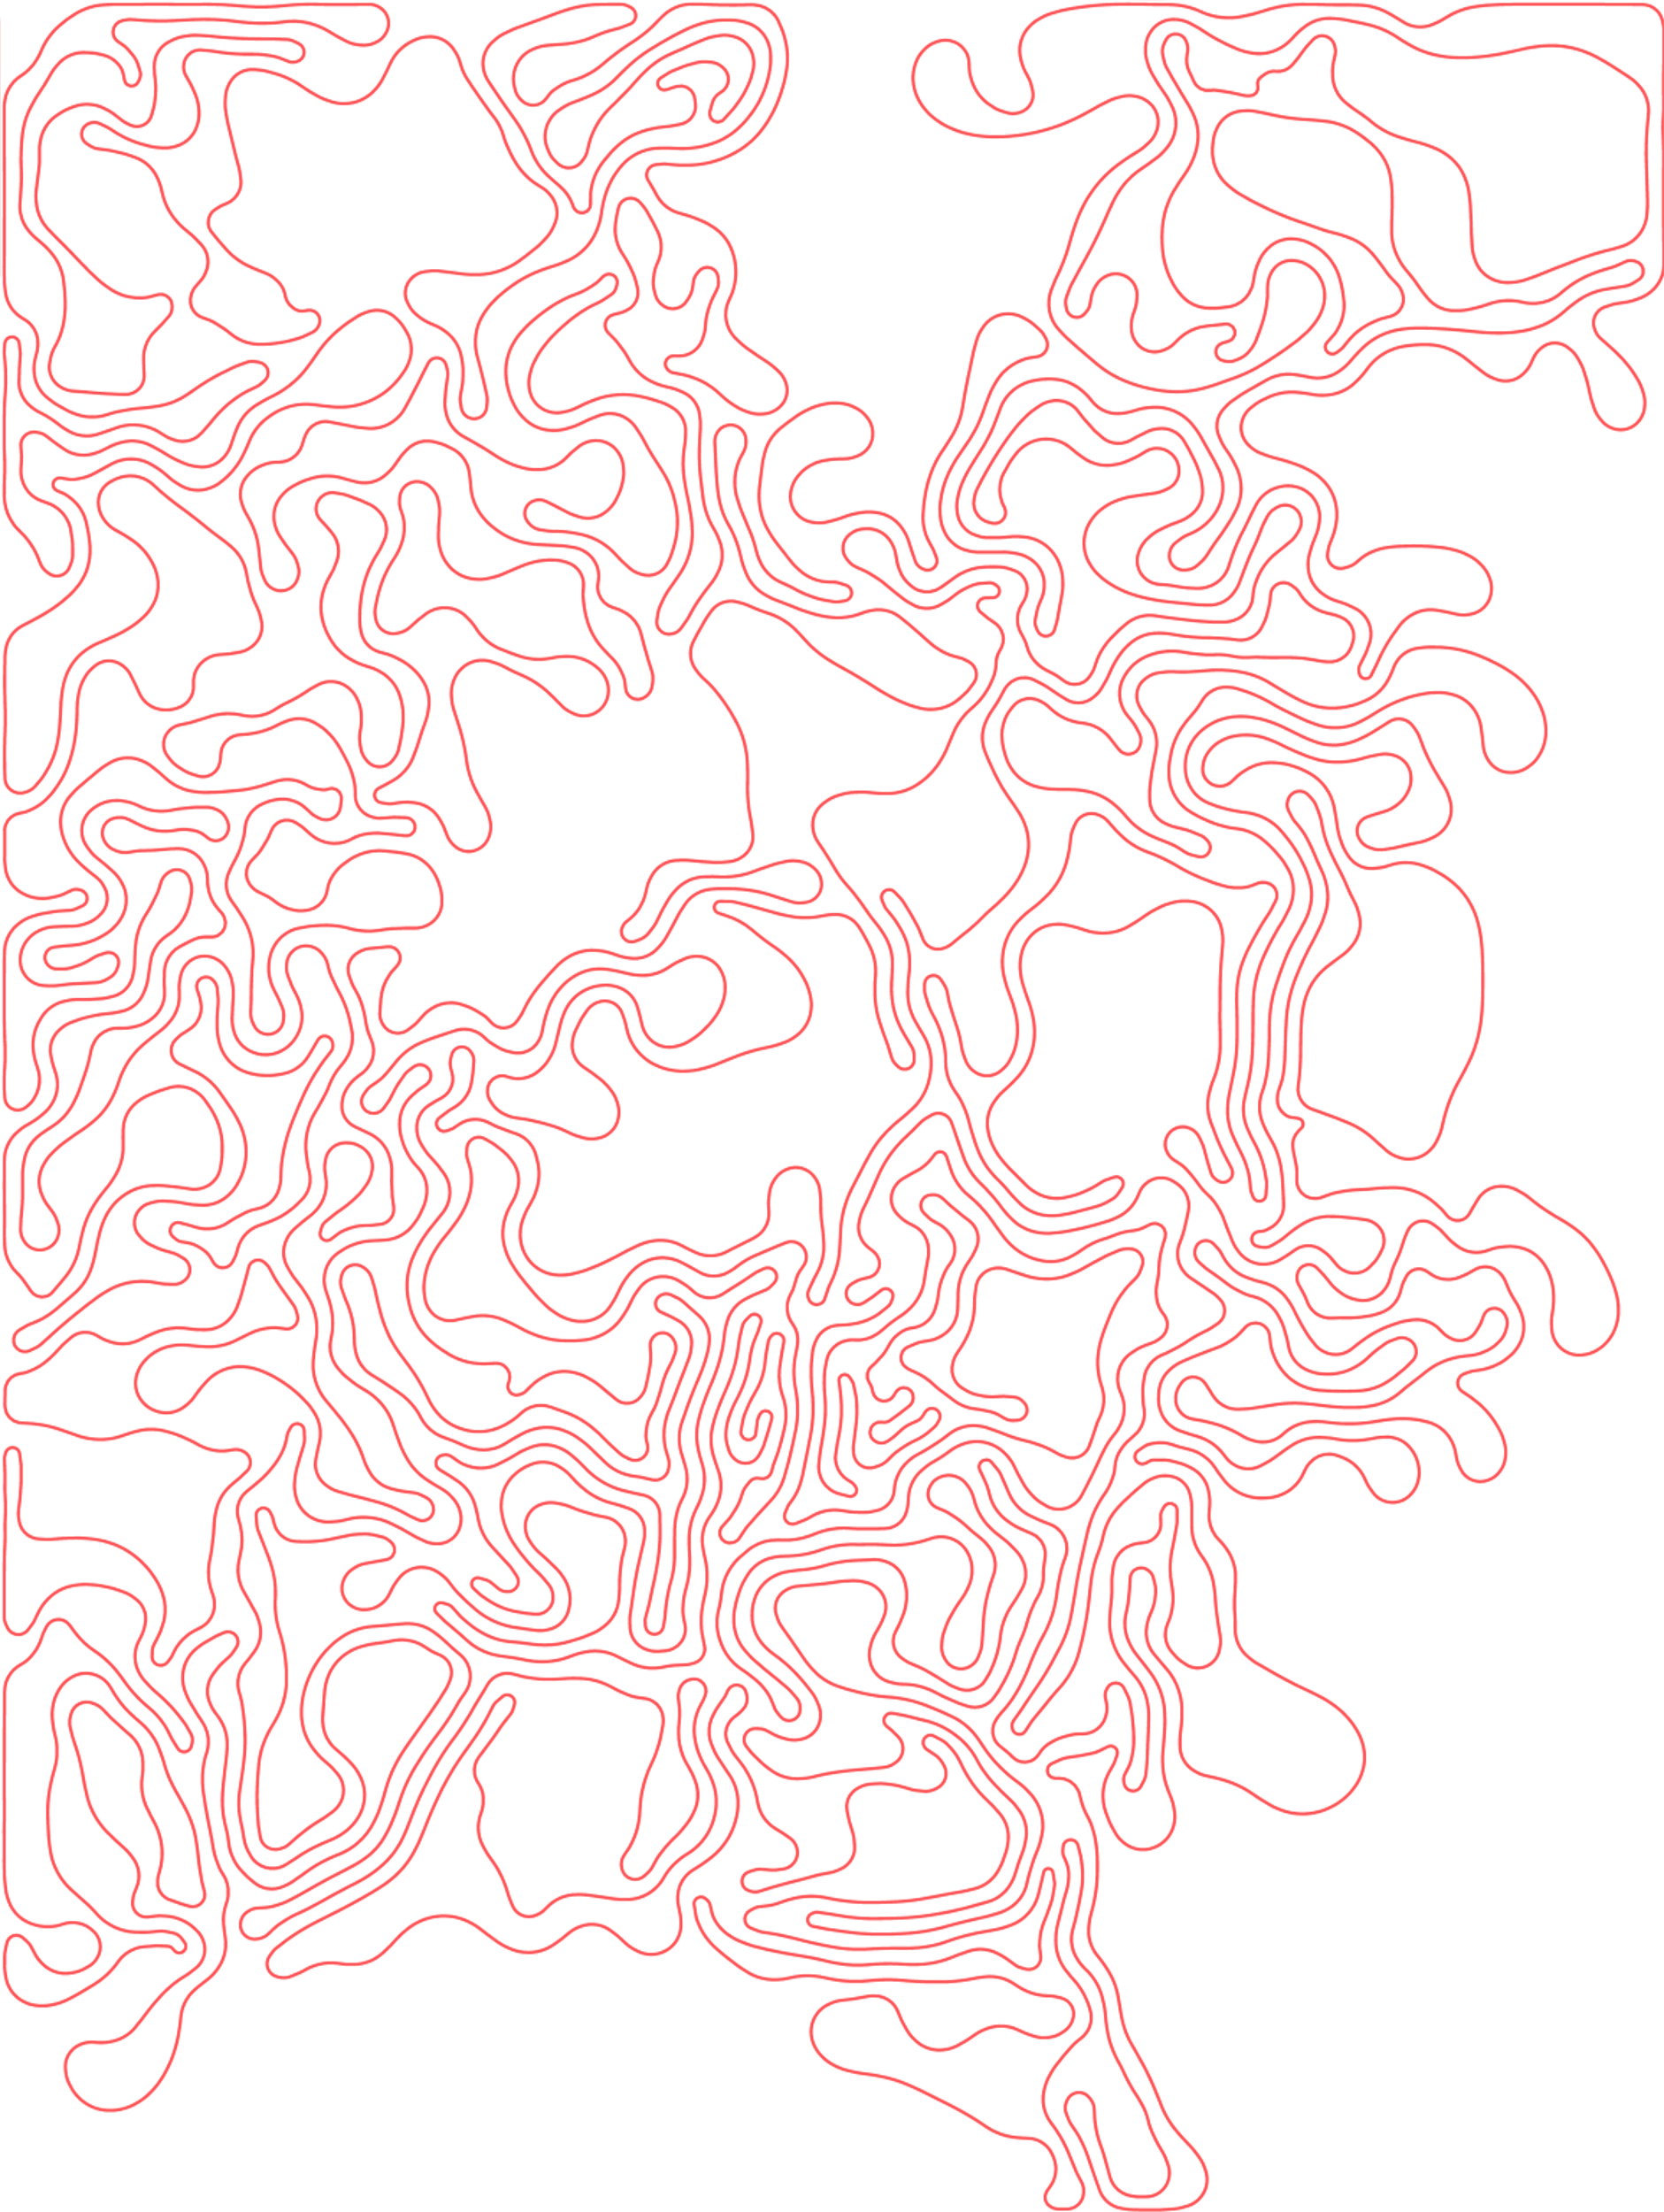

Slide 48
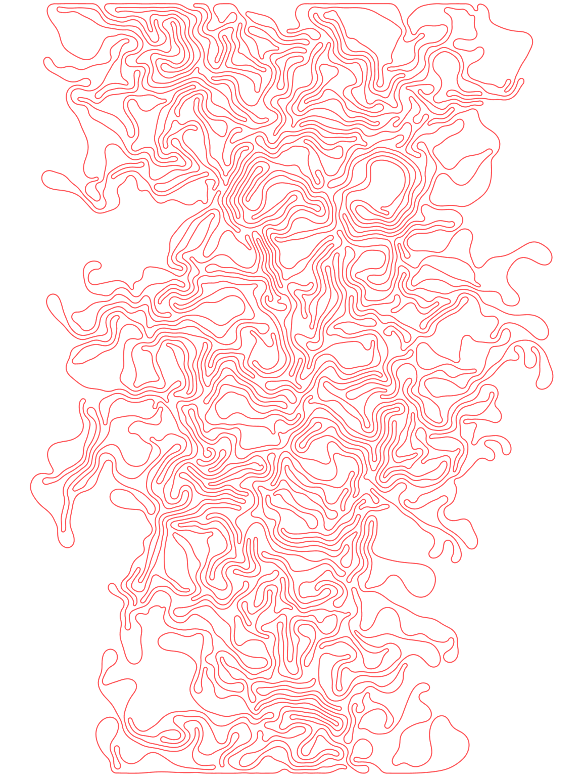

Slide 49
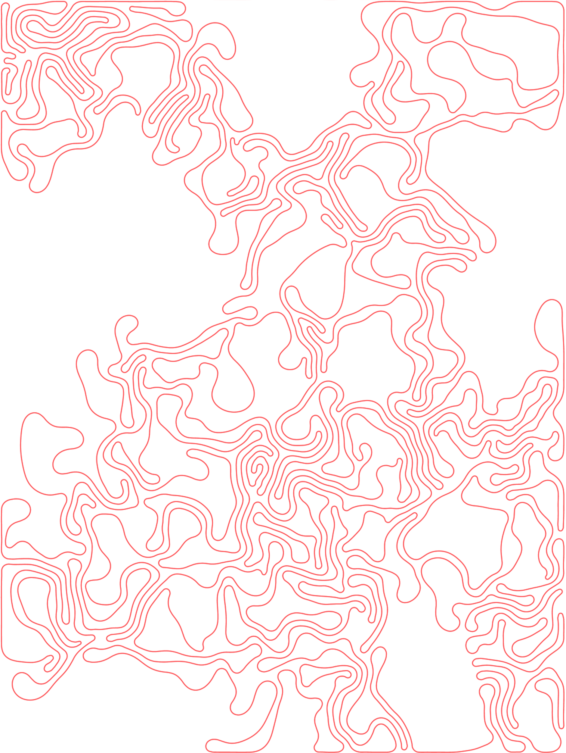

Slide 50
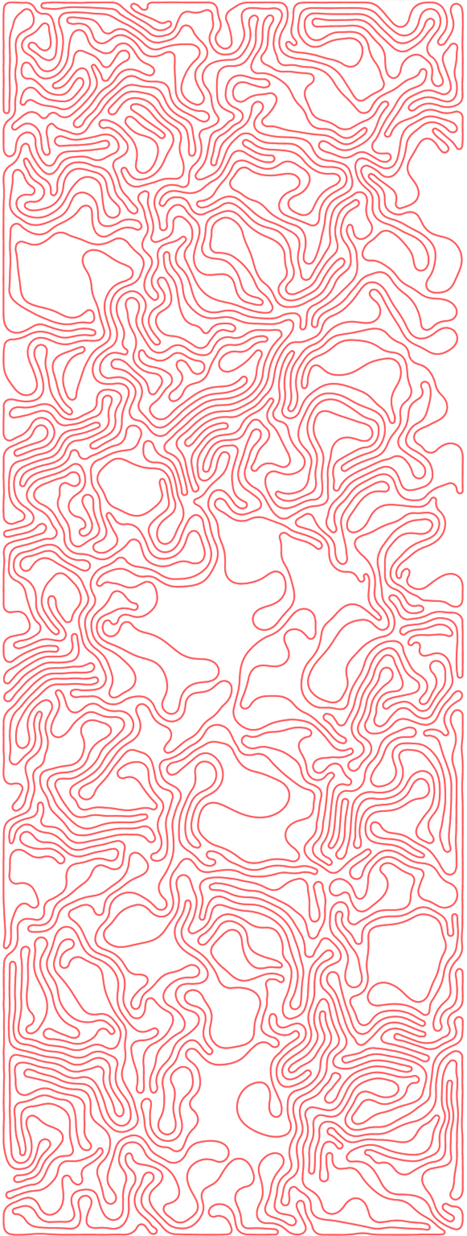

Slide 51
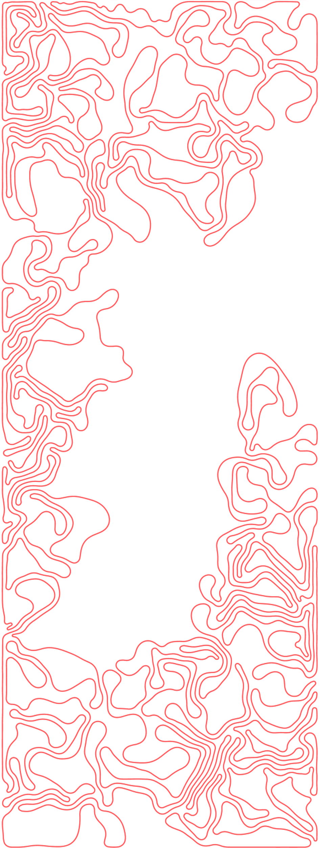

Slide 52
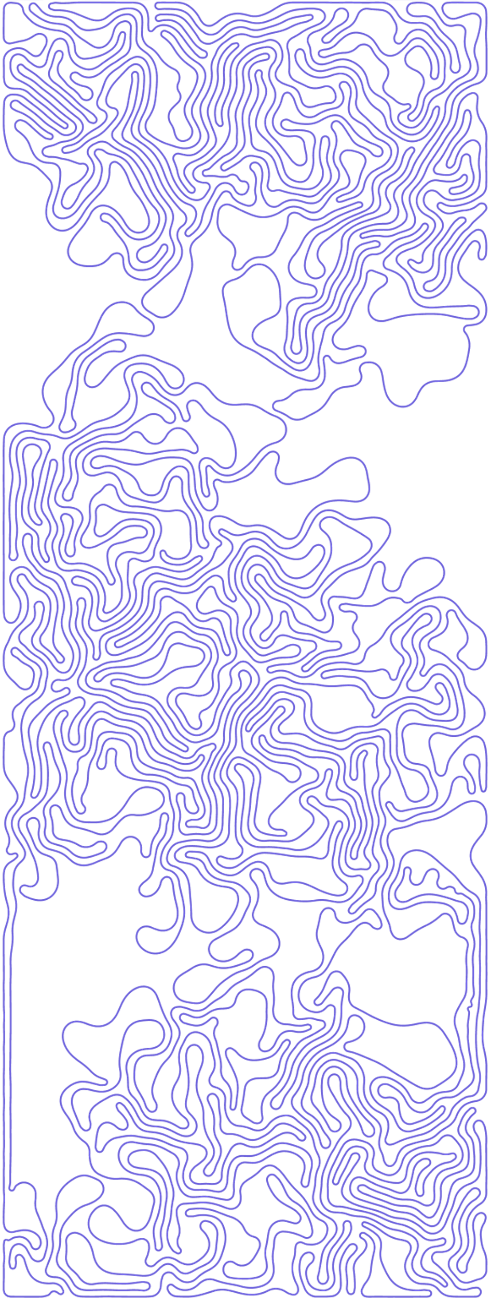

Slide 53
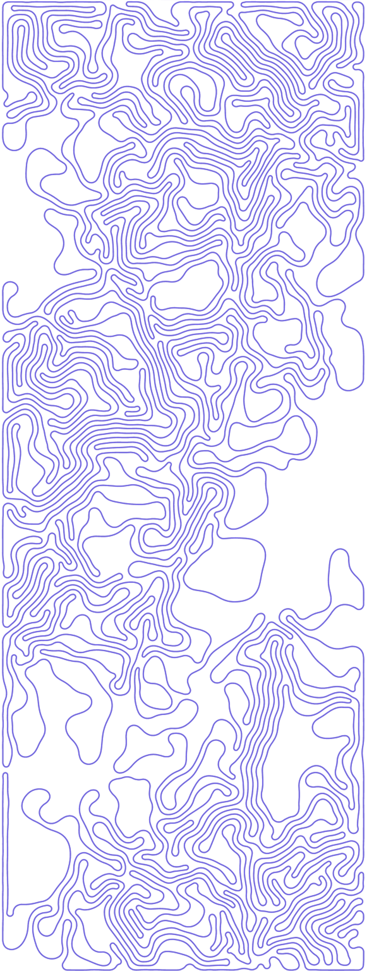

Slide 54


Slide 55


Slide 56


Slide 57


Slide 58


Slide 59


Slide 60
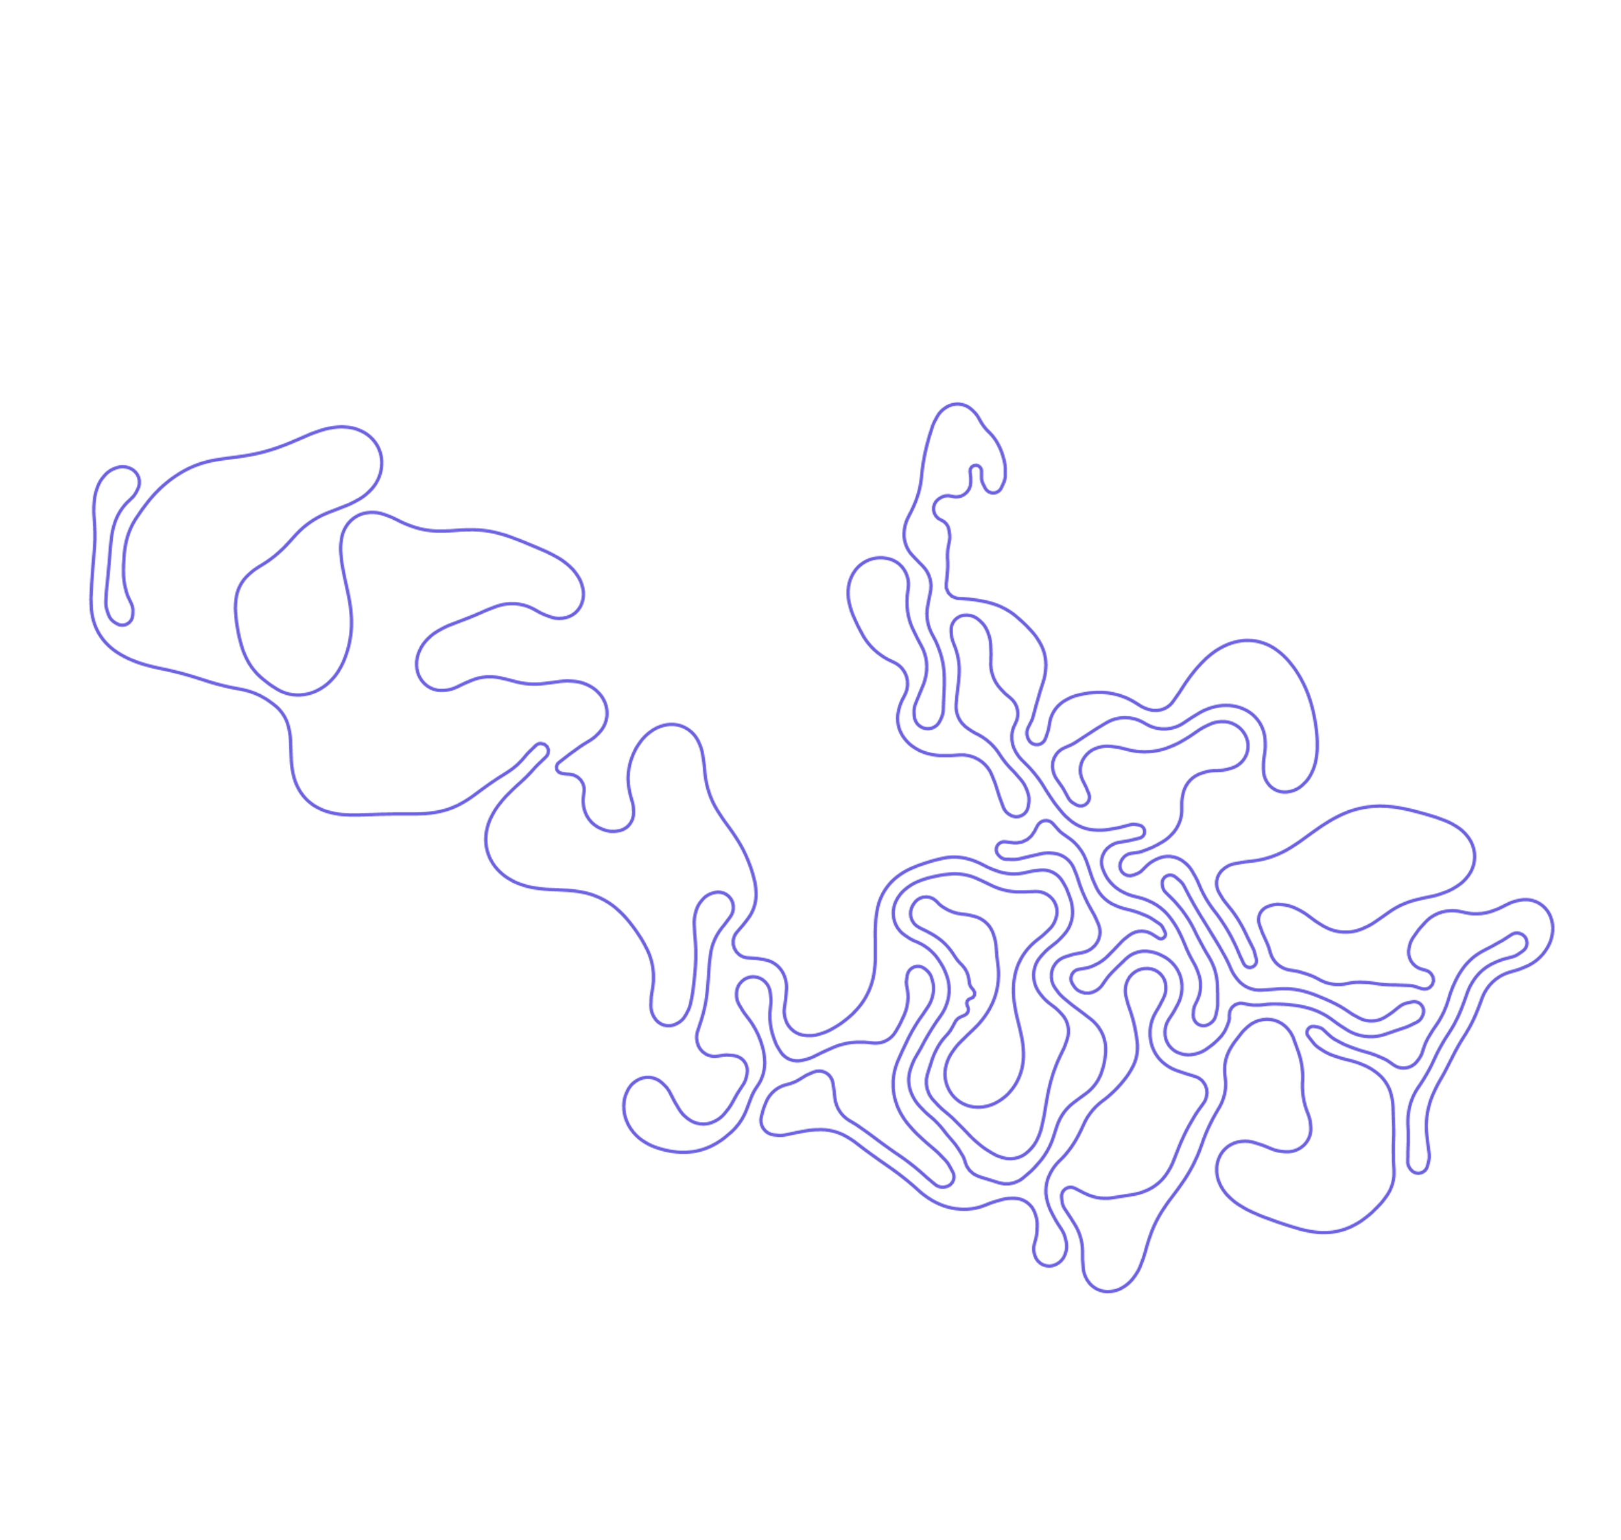

Slide 61


Slide 62


Slide 63


Slide 64


Slide 65
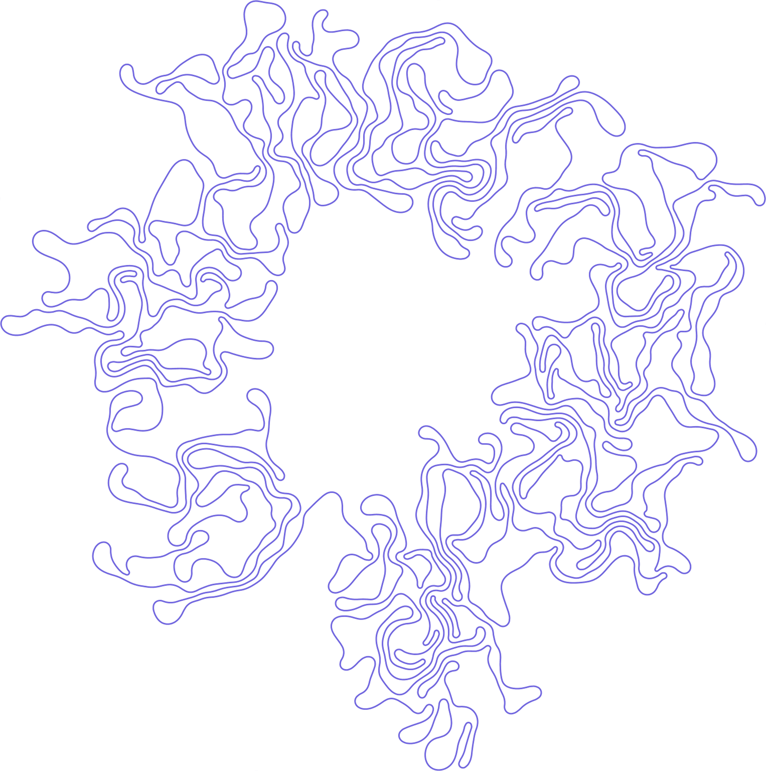

Slide 66
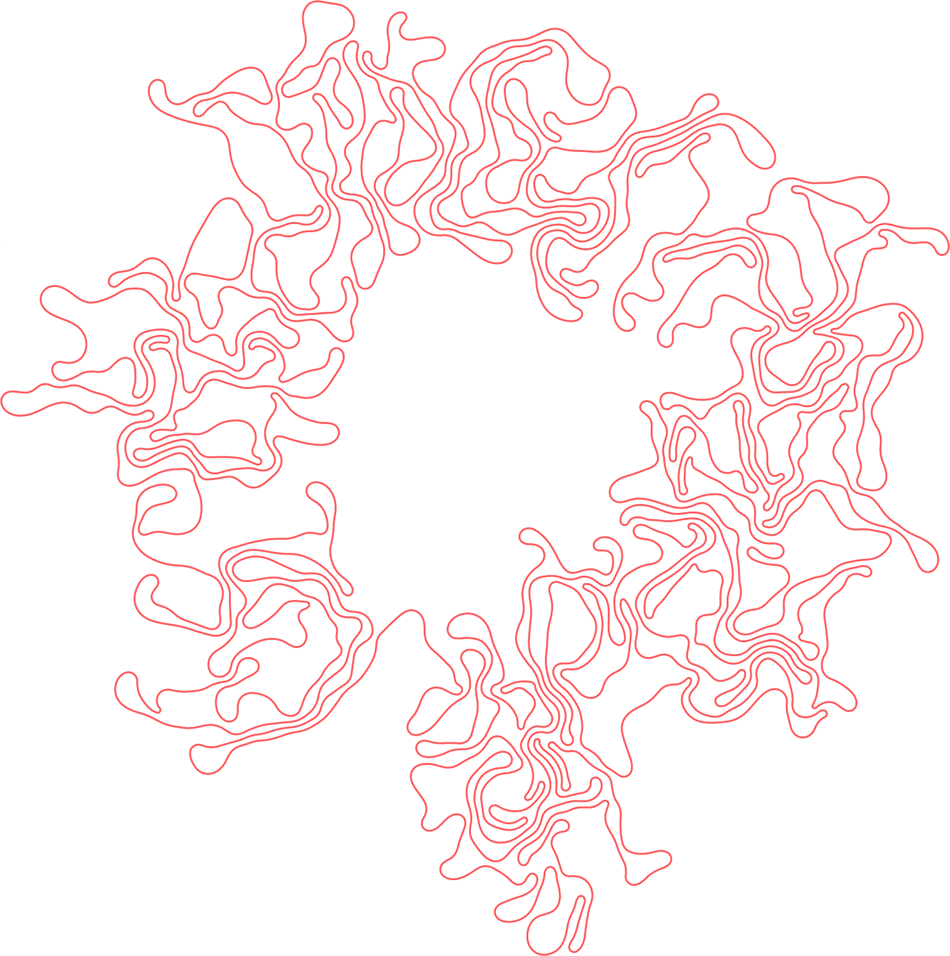

Slide 67
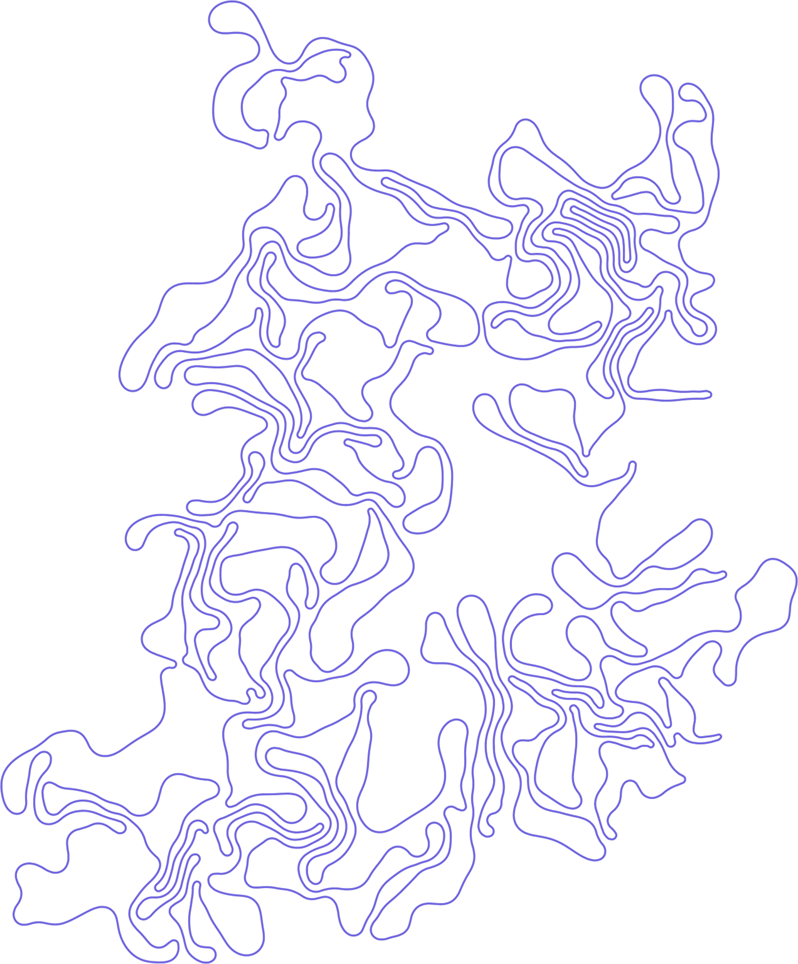

Slide 68


Slide 69
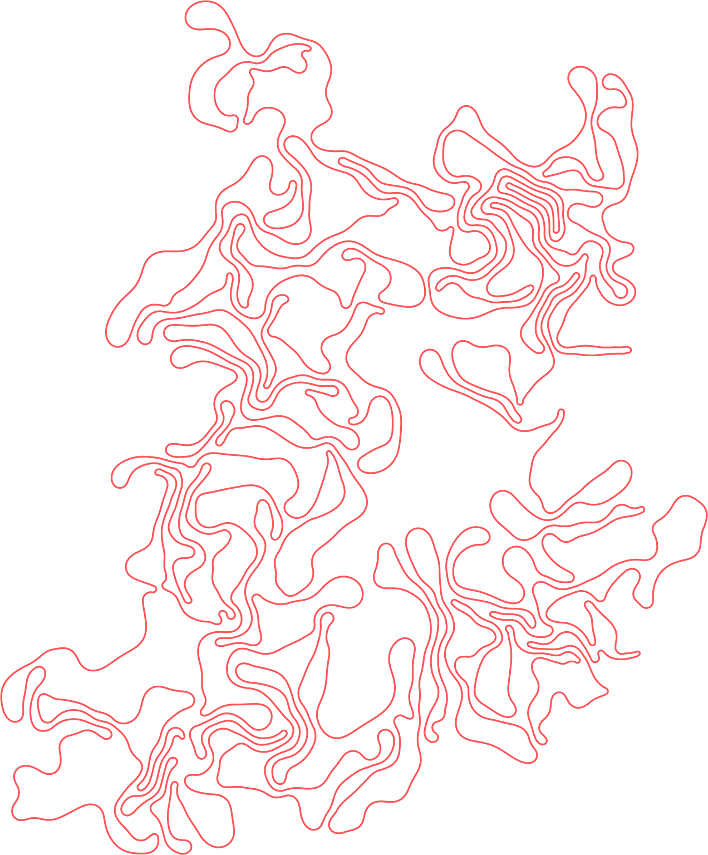

Slide 70


Slide 71
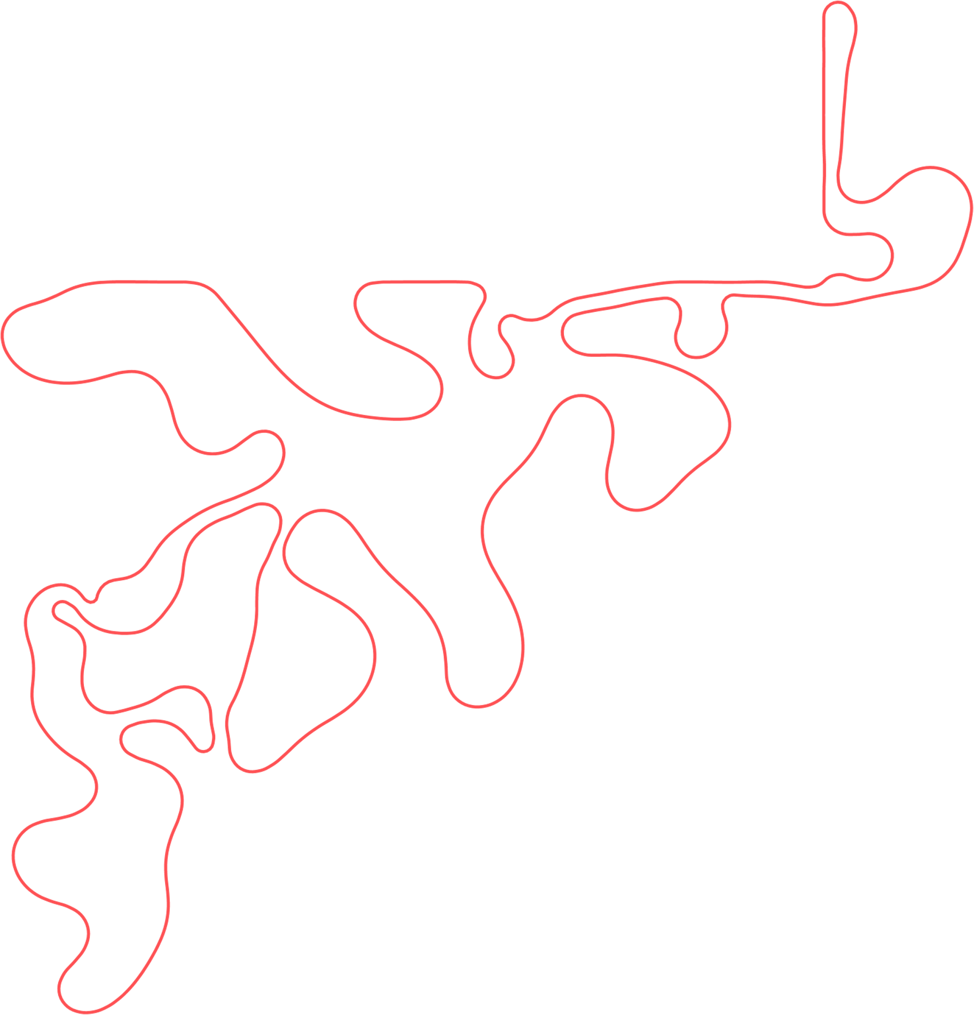

Slide 72


Slide 73


Slide 74


Slide 75






























































































































































Slide 76


























































































































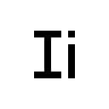






















































Slide 77
































































































































































































Slide 78












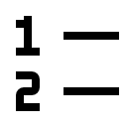








































































































































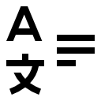











































Slide 79


















































































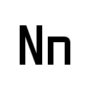














































































































Slide 80







































